Slide 1
Introduction to Relational model

Slide 2
Syllabus
Introduction to the Relational Model and Relational Database Design:
Relational Model: Structure of Relational Databases, Database Schema, Keys, Schema Diagram, Relational Query Languages, Introduction to Relational Algebra Queries: Basic Relational Algebra Operators, Introduction to Views
Relational Database Design: Features of Good Relational Designs, Functional Dependencies, Normal Forms – 1NF, 2NF, 3NF and BCNF

Slide 3
What is Relational Model?
Relational Model (RM) represents the database as a collection of relations. A relation is nothing but a table of values. Every row in the table represents a collection of related data values. These rows in the table denote a real-world entity or relationship.
The table name and column names are helpful to interpret the meaning of values in each row. The data are represented as a set of relations. In the relational model, data are stored as tables. However, the physical storage of the data is independent of the way the data are logically organized.

Slide 4
Relational Model Concepts
Attribute: Each column in a Table. Attributes are the properties which define a relation. e.g., Student_Rollno, NAME,etc.
Tables – In the Relational model the, relations are saved in the table format. It is stored along with its entities. A table has two properties rows and columns. Rows represent records and columns represent attributes.
Tuple – It is nothing but a single row of a table, which contains a single record.
Relation Schema: A relation schema represents the name of the relation with its attributes.
Degree: The total number of attributes which in the relation is called the degree of the relation.

Slide 5
Cardinality: Total number of rows present in the Table.
Column: The column represents the set of values for a specific attribute.
Relation instance – Relation instance is a finite set of tuples in the RDBMS system. Relation instances never have duplicate tuples.
Relation key - Every row has one, two or multiple attributes, which is called relation key.
Attribute domain – Every attribute has some pre-defined value and scope which is known as attribute domain

Slide 6
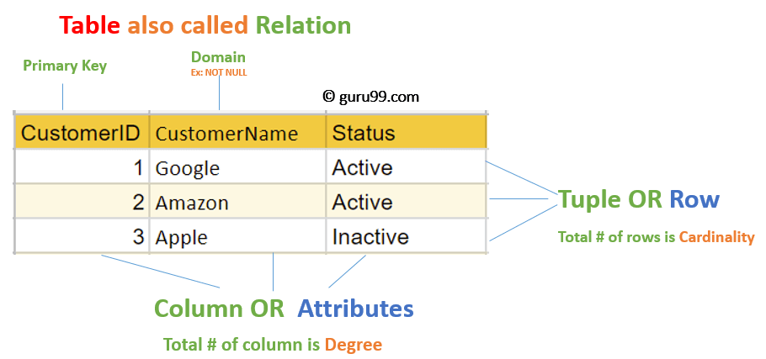

Slide 7
Relational Integrity Constraints
Relational Integrity constraints in DBMS are referred to conditions which must be present for a valid relation. These Relational constraints in DBMS are derived from the rules in the mini-world that the database represents.
There are many types of Integrity Constraints in DBMS. Constraints on the Relational database management system is mostly divided into three main categories are:
Domain Constraints
Key Constraints
Referential Integrity Constraints

Slide 8
Domain Constraints
Domain constraints can be violated if an attribute value is not appearing in the corresponding domain or it is not of the appropriate data type.
Domain constraints specify that within each tuple, and the value of each attribute must be unique. This is specified as data types which include standard data types integers, real numbers, characters, Booleans, variable length strings, etc.
Example:
Create Domain CustomerName
Check(value not null)

Slide 9
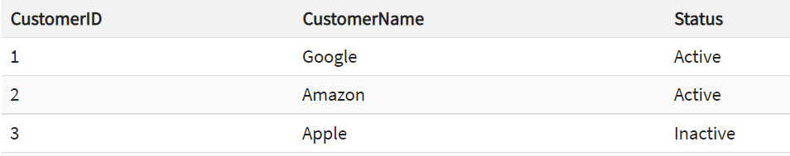
Key Constraints
An attribute that can uniquely identify a tuple in a relation is called the key of the table. The value of the attribute for different tuples in the relation has to be unique.
Example:
In the given table, CustomerID is a key attribute of Customer Table. It is most likely to have a single key for one customer, CustomerID =1 is only for the CustomerName =" Google".

Slide 10
Referential Integrity Constraints
Referential Integrity constraints in DBMS are based on the concept of Foreign Keys.
A foreign key is an important attribute of a relation which should be referred to in other relationships.
Referential integrity constraint state happens where relation refers to a key attribute of a different or same relation.
However, that key element must exist in the table.

Slide 11
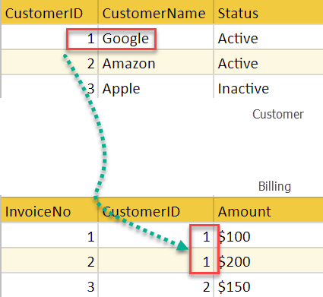
Example:
In the below example, we have 2 relations, Customer and Billing. Tuple for CustomerID =1 is referenced twice in the relation Billing. So we know CustomerName=Google has billing amount $300

Slide 12
Operations in Relational Model
Our basic update operations performed on relational database model are
Insert, update, delete and select.
Insert is used to insert data into the relation
Delete is used to delete tuples from the table.
Modify allows you to change the values of some attributes in existing tuples.
Select allows you to choose a specific range of data.
Whenever one of these operations are applied, integrity constraints specified on the relational database schema must never be violated.

Slide 13
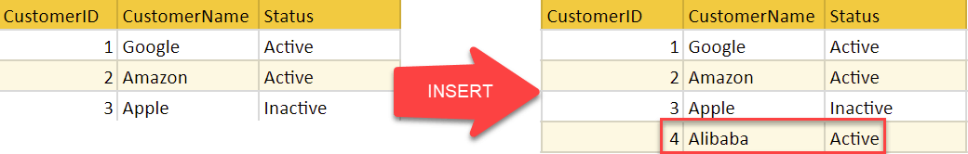
Insert Operation:
The insert operation gives values of the attribute for a new tuple which should be inserted into a relation.

Slide 14
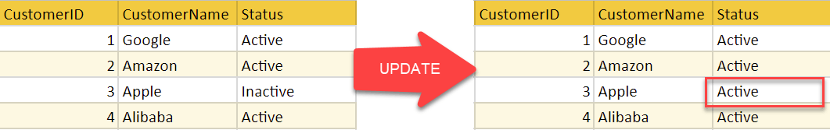
Update Operation:
You can see that in the below-given relation table CustomerName= 'Apple' is updated from Inactive to Active.

Slide 15
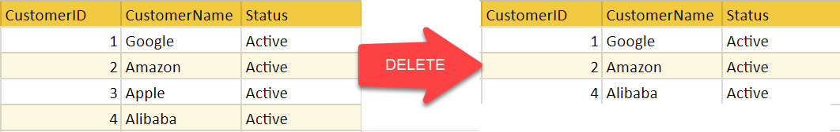
Delete Operation:
To specify deletion, a condition on the attributes of the relation selects the tuple to be deleted.
In the below-given example,
CustomerName= "Apple" is deleted from the table.
The Delete operation could violate referential integrity if the tuple which is deleted is referenced by foreign keys from other tuples in the same database.

Slide 16
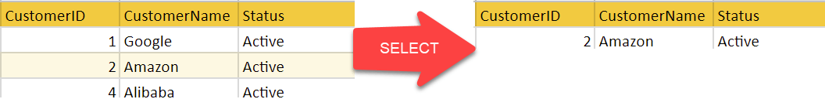
Select Operation
In the below-given example, CustomerName="Amazon" is selected

Slide 17
Best Practices for creating a Relational Model
Data need to be represented as a collection of relations
Each relation should be depicted clearly in the table
Rows should contain data about instances of an entity
Columns must contain data about attributes of the entity
Cells of the table should hold a single value
Each column should be given a unique name
No two rows can be identical
The values of an attribute should be from the same domain

Slide 18
Advantages of using Relational Model
Simplicity: A Relational data model in DBMS is simpler than the hierarchical and network model.
Structural Independence: The relational database is only concerned with data and not with a structure. This can improve the performance of the model.
Easy to use: The Relational model in DBMS is easy as tables consisting of rows and columns are quite natural and simple to understand
Query capability: It makes possible for a high-level query language like SQL to avoid complex database navigation.
Data independence: The Structure of Relational database can be changed without having to change any application.
Scalable: Regarding a number of records, or rows, and the number of fields, a database should be enlarged to enhance its usability.

Slide 19
Disadvantages of using Relational Model
Few relational databases have limits on field lengths which can't be exceeded.
Relational databases can sometimes become complex as the amount of data grows, and the relations between pieces of data become more complicated.
Complex relational database systems may lead to isolated databases where the information cannot be shared from one system to another.

Slide 20
ANOMALIES
An anomaly is an irregularity, or something which deviates from the expected or normal state. When designing databases, we identify three types of anomalies: Insert, Update and Delete.

Slide 23
Insertion Anomaly in Referencing Relation:
We can’t insert a row in REFERENCING RELATION if referencing attribute’s value is not present in referenced attribute value. e.g.; Insertion of a student with BRANCH_CODE ‘ME’ in STUDENT relation will result in error because ‘ME’ is not present in BRANCH_CODE of BRANCH.

Slide 24
Deletion/ Updation Anomaly in Referenced Relation:
We can’t delete or update a row from REFERENCED RELATION if value of REFERENCED ATTRIBUTE is used in value of REFERENCING ATTRIBUTE. e.g; if we try to delete tuple from BRANCH having BRANCH_CODE ‘CS’, it will result in error because ‘CS’ is referenced by BRANCH_CODE of STUDENT, but if we try to delete the row from BRANCH with BRANCH_CODE CV, it will be deleted as the value is not been used by referencing relation.

Slide 25
ON DELETE CASCADE
It will delete the tuples from REFERENCING RELATION if value used by REFERENCING ATTRIBUTE is deleted from REFERENCED RELATION. e.g;, if we delete a row from BRANCH with BRANCH_CODE ‘CS’, the rows in STUDENT relation with BRANCH_CODE CS (ROLL_NO 1 and 2 in this case) will be deleted.

Slide 26
ON UPDATE CASCADE:
It will update the REFERENCING ATTRIBUTE in REFERENCING RELATION if attribute value used by REFERENCING ATTRIBUTE is updated in REFERENCED RELATION. e.g;, if we update a row from BRANCH with BRANCH_CODE ‘CS’ to ‘CSE’, the rows in STUDENT relation with BRANCH_CODE CS (ROLL_NO 1 and 2 in this case) will be updated with BRANCH_CODE ‘CSE’.

Slide 27
SUPER KEYS:
Any set of attributes that allows us to identify unique rows (tuples) in a given relation are known as super keys. Out of these super keys we can always choose a proper subset among these which can be used as a primary key. Such keys are known as Candidate keys. If there is a combination of two or more attributes which is being used as the primary key then we call it as a Composite key.

Slide 28
Relational Algebra
Relational algebra is a procedural query language that works on relational model. The purpose of a query language is to retrieve data from database or perform various operations such as insert, update, delete on the data. When I say that relational algebra is a procedural query language, it means that it tells what data to be retrieved and how to be retrieved.
On the other hand relational calculus is a non-procedural query language, which means it tells what data to be retrieved but doesn’t tell how to retrieve it. We will discuss relational calculus in a separate tutorial.

Slide 29
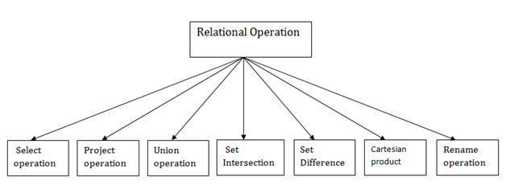
Types of Relational operation

Slide 30
Types of operations in relational algebra
We have divided these operations in two categories:
1. Basic Operations
2. Derived Operations

Slide 31
Basic/Fundamental Operations:
1. Select (σ)
2. Project (∏)
3. Union (∪)
4. Set Difference (-)
5. Cartesian product (X)
6. Rename (ρ)

Slide 32
Derived Operations:
1. Natural Join (⋈)
2. Left, Right, Full outer join (⟕, ⟖, ⟗)
3. Intersection (∩)
4. Division (÷)

Slide 33
Select Operator (σ)
The select operation selects tuples that satisfy a given predicate.
It is denoted by sigma (σ).
Notation: σ p(r)
Where:
σ is used for selection prediction
r is used for relation
p is used as a propositional logic formula which may use connectors like: AND OR and NOT. These relational can use as relational operators like =, ≠, ≥, <, >, ≤.

Slide 34
For example: LOAN Relation
BRANCH_NAME | LOAN_NO | AMOUNT
Downtown | L-17 | 1000
Redwood | L-23 | 2000
Perryride | L-15 | 1500
Downtown | L-14 | 1500
Mianus | L-13 | 500
Roundhill | L-11 | 900
Perryride | L-16 | 1300
Input:
σ BRANCH_NAME="perryride" (LOAN)
BRANCH_NAME | LOAN_NO | AMOUNT
Perryride | L-15 | 1500
Perryride | L-16 | 1300

Slide 35
2. Project Operation:
This operation shows the list of those attributes that we wish to appear in the result. Rest of the attributes are eliminated from the table.
It is denoted by ∏.
Notation: ∏ A1, A2, An (r)
Where
A1, A2, A3 is used as an attribute name of relation r.

Slide 36
Example: CUSTOMER RELATION
Input:
∏ NAME, CITY (CUSTOMER)
Output
NAME | STREET | CITY
Jones | Main | Harrison
Smith | North | Rye
Hays | Main | Harrison
Curry | North | Rye
Johnson | Alma | Brooklyn
Brooks | Senator | Brooklyn
NAME | CITY
Jones | Harrison
Smith | Rye
Hays | Harrison
Curry | Rye
Johnson | Brooklyn
Brooks | Brooklyn

Slide 37
3. Union Operation:
Suppose there are two tuples R and S. The union operation contains all the tuples that are either in R or S or both in R & S.
It eliminates the duplicate tuples. It is denoted by ∪.
Notation: R ∪ S
A union operation must hold the following condition:
R and S must have the attribute of the same number.
Duplicate tuples are eliminated automatically.

Slide 38
Example:
DEPOSITOR RELATION
BORROW RELATION
CUSTOMER_NAME | ACCOUNT_NO
Johnson | A-101
Smith | A-121
Mayes | A-321
Turner | A-176
Johnson | A-273
Jones | A-472
Lindsay | A-284
CUSTOMER_NAME | LOAN_NO
Jones | L-17
Smith | L-23
Hayes | L-15
Jackson | L-14
Curry | L-93
Smith | L-11
Williams | L-17

Slide 39
Input:
∏ CUSTOMER_NAME (BORROW) ∪ ∏ CUSTOMER_NAME (DEPOSITOR)
Output:
CUSTOMER_NAME
Johnson
Smith
Hayes
Turner
Jones
Lindsay
Jackson
Curry
Williams
Mayes

Slide 40
4. Set Intersection:
Suppose there are two tuples R and S. The set intersection operation contains all tuples that are in both R & S.
It is denoted by intersection ∩.
Notation: R ∩ S
Example: Using the above DEPOSITOR table and BORROW table

Slide 41
Input:
∏ CUSTOMER_NAME (BORROW) ∩ ∏ CUSTOMER_NAME (DEPOSITOR)
Output:
CUSTOMER_NAME
Smith
Jones

Slide 42
5. Set Difference:
Suppose there are two tuples R and S. The set intersection operation contains all tuples that are in R but not in S.
It is denoted by intersection minus (-).
Notation: R - S
Example: Using the above DEPOSITOR table and BORROW table

Slide 43
Input:
∏ CUSTOMER_NAME (BORROW) - ∏ CUSTOMER_NAME (DEPOSITOR)
Output:
CUSTOMER_NAME
Jackson
Hayes
Willians
Curry

Slide 44
6. Cartesian product
The Cartesian product is used to combine each row in one table with each row in the other table. It is also known as a cross product.
It is denoted by X.
Notation: E X D

Slide 45
Example:
EMPLOYEE
DEPARTMENT
EMP_ID | EMP_NAME | EMP_DEPT
1 | Smith | A
2 | Harry | C
3 | John | B
DEPT_NO | DEPT_NAME
A | Marketing
B | Sales
C | Legal

Slide 46
Input:
EMPLOYEE X DEPARTMENT
Output:
EMP_ID | EMP_NAME | EMP_DEPT | DEPT_NO | DEPT_NAME
1 | Smith | A | A | Marketing
1 | Smith | A | B | Sales
1 | Smith | A | C | Legal
2 | Harry | C | A | Marketing
2 | Harry | C | B | Sales
2 | Harry | C | C | Legal
3 | John | B | A | Marketing
3 | John | B | B | Sales
3 | John | B | C | Legal

Slide 47
7. Rename Operation:
The rename operation is used to rename the output relation. It is denoted by rho (ρ).
Example: We can use the rename operator to rename STUDENT relation to STUDENT1.
ρ(STUDENT1, STUDENT)

Slide 48
Join Operations:
A Join operation combines related tuples from different relations, if and only if a given join condition is satisfied. It is denoted by ⋈.

Slide 49
Example:
EMPLOYEE
SALARY
EMP_CODE | EMP_NAME
101 | Stephan
102 | Jack
103 | Harry
EMP_CODE | SALARY
101 | 50000
102 | 30000
103 | 25000

Slide 50
Operation: (EMPLOYEE ⋈ SALARY)
Result:
EMP_CODE | EMP_NAME | SALARY
101 | Stephan | 50000
102 | Jack | 30000
103 | Harry | 25000

Slide 51
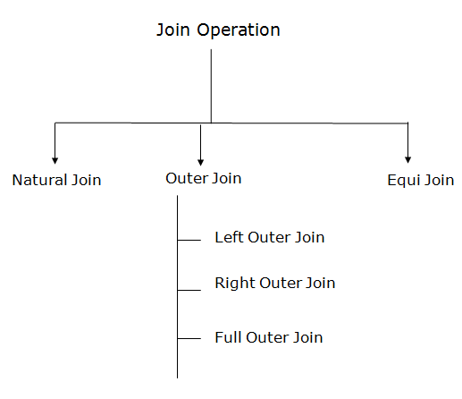
Types of Join operations:

Slide 52
1. Natural Join:
A natural join is the set of tuples of all combinations in R and S that are equal on their common attribute names.
It is denoted by ⋈.
Example: Let's use the above EMPLOYEE table and SALARY table:
Input:
∏EMP_NAME, SALARY (EMPLOYEE ⋈ SALARY)
Output:
EMP_NAME | SALARY
Stephan | 50000
Jack | 30000
Harry | 25000

Slide 53
2. Outer Join:
The outer join operation is an extension of the join operation. It is used to deal with missing information.
EMPLOYEE
FACT_WORKERS
EMP_NAME | STREET | CITY
Ram | Civil line | Mumbai
Shyam | Park street | Kolkata
Ravi | M.G. Street | Delhi
Hari | Nehru nagar | Hyderabad
EMP_NAME | BRANCH | SALARY
Ram | Infosys | 10000
Shyam | Wipro | 20000
Kuber | HCL | 30000
Hari | TCS | 50000

Slide 54
Input: (EMPLOYEE ⋈ FACT_WORKERS)
Output:
EMP_NAME | STREET | CITY | BRANCH | SALARY
Ram | Civil line | Mumbai | Infosys | 10000
Shyam | Park street | Kolkata | Wipro | 20000
Hari | Nehru nagar | Hyderabad | TCS | 50000

Slide 55
An outer join is basically of three types:
Left outer join
Right outer join
Full outer join

Slide 56
a. Left outer join:
Left outer join contains the set of tuples of all combinations in R and S that are equal on their common attribute names.
In the left outer join, tuples in R have no matching tuples in S.
It is denoted by ⟕.
Example: Using the above EMPLOYEE table and FACT_WORKERS table

Slide 57
Input:
EMPLOYEE ⟕ FACT_WORKERS
EMP_NAME | STREET | CITY | BRANCH | SALARY
Ram | Civil line | Mumbai | Infosys | 10000
Shyam | Park street | Kolkata | Wipro | 20000
Hari | Nehru street | Hyderabad | TCS | 50000
Ravi | M.G. Street | Delhi | NULL | NULL

Slide 58
b. Right outer join:
Right outer join contains the set of tuples of all combinations in R and S that are equal on their common attribute names.
In right outer join, tuples in S have no matching tuples in R.
It is denoted by ⟖.
Example: Using the above EMPLOYEE table and FACT_WORKERS Relation

Slide 59
Input:
EMPLOYEE ⟖ FACT_WORKERS
Output:
EMP_NAME | BRANCH | SALARY | STREET | CITY
Ram | Infosys | 10000 | Civil line | Mumbai
Shyam | Wipro | 20000 | Park street | Kolkata
Hari | TCS | 50000 | Nehru street | Hyderabad
Kuber | HCL | 30000 | NULL | NULL

Slide 60
c. Full outer join:
Full outer join is like a left or right join except that it contains all rows from both tables.
In full outer join, tuples in R that have no matching tuples in S and tuples in S that have no matching tuples in R in their common attribute name.
It is denoted by ⟗.
Example: Using the above EMPLOYEE table and FACT_WORKERS table

Slide 61
Input:
EMPLOYEE ⟗ FACT_WORKERS
Output:
EMP_NAME | STREET | CITY | BRANCH | SALARY
Ram | Civil line | Mumbai | Infosys | 10000
Shyam | Park street | Kolkata | Wipro | 20000
Hari | Nehru street | Hyderabad | TCS | 50000
Ravi | M.G. Street | Delhi | NULL | NULL
Kuber | NULL | NULL | HCL | 30000

Slide 62
3. Equi join:
It is also known as an inner join. It is the most common join. It is based on matched data as per the equality condition. The equi join uses the comparison operator(=).
CUSTOMER RELATION
PRODUCT
CLASS_ID | NAME
1 | John
2 | Harry
3 | Jackson
PRODUCT_ID | CITY
1 | Delhi
2 | Mumbai
3 | Noida

Slide 63
Input:
CUSTOMER ⋈ PRODUCT
Output:
CLASS_ID | NAME | PRODUCT_ID | CITY
1 | John | 1 | Delhi
2 | Harry | 2 | Mumbai
3 | Harry | 3 | Noida

